Slide 1
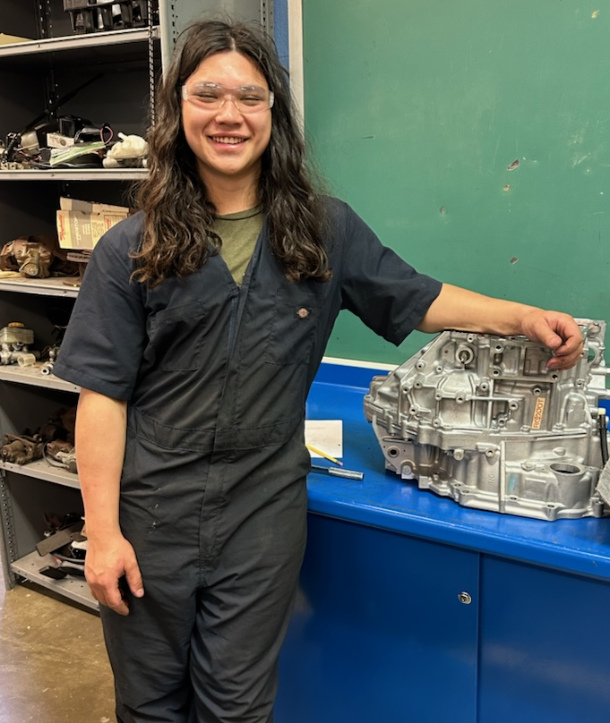
STUDENT SPOTLIGHT
Leo Brown
Leo Brown is a junior in the Level 2 Automotive Technology program at CAT North. He wasn’t very familiar with CAT North programs, but he submit his application after a friend mentioned the opportunity during his freshman year. Leo said that he “was lucky enough to get a spot in the Automotive Technology program”, a program which gets a significant number of applicants each school year. Now, Leo couldn’t imagine his high school experience without CAT North.
When asked what was his favorite things about CAT North, Leo took a few moments to decide and then, confidently stated the following:
“The instructors. They care about you more than the work that you do in the classroom. They ask about our lives and share about theirs. It’s more personal because we know they care. CAT North doesn’t even seem like a school. Everything is different and I enjoy it so much!”
Leo’s experience at CAT North has helped him find his passion for automotives and a drive to pursue a career in the industry. He currently works at Eastwood Automotive in Pasadena, MD. While he isn’t working in a shop (yet), he loves using his knowledge and experience to help customers who are less familiar with the trade. He is planning to start an apprenticeship with the Maryland State Highway Administration next year.
Leo recently won first place for his performance in Automotive Service Technology at the SkillsUSA Maryland State Competition. He is excited to compete in the SkillsUSA National Leadership & Skills Conference in Atlanta, GA, in June. We are confident that Leo will continue to represent CAT North proudly as he seeks out another Gold Medal!
Great job, Leo! We’re rooting for you!
Notes:
0:30 – 19:30
COMMON THREAD – ALL GENERATIONAL BASED PROJECT THAT LOOK FORWARD TO SOLVING A COMMUNITIES CURRENT AND FUTURE CHALLENGES THAT RELATE TO THE HUMAN CONDITION – DESIGNED FOR PEOPLE, NOT GIANT INSTITUTIONS – THEY REQUIRE INPUT FROM MULTIPLE FOCUS GROUPS , AND WHEN DONE WELL CONTRIBUTE TO THE FABRIC OF A COMMUNITY. ESSENTIALLY – THEY ARE PERSONAL AND REQUIRE AN INTIMATE HANDS-ON APPROACH

